Slide 1
Health Equity OKR 2021: Establishing Baseline Measures
July 27, 2021
Leo Zhou

Slide 2

Outline
Background
Tables for EBM by race
- Aggregated measures
- Overuse measures
- Underuse measures
EBM analysis
- Exploratory data analysis (EDA)
- Methods
- Results
Challenges
Next steps
Bibliography

Slide 3
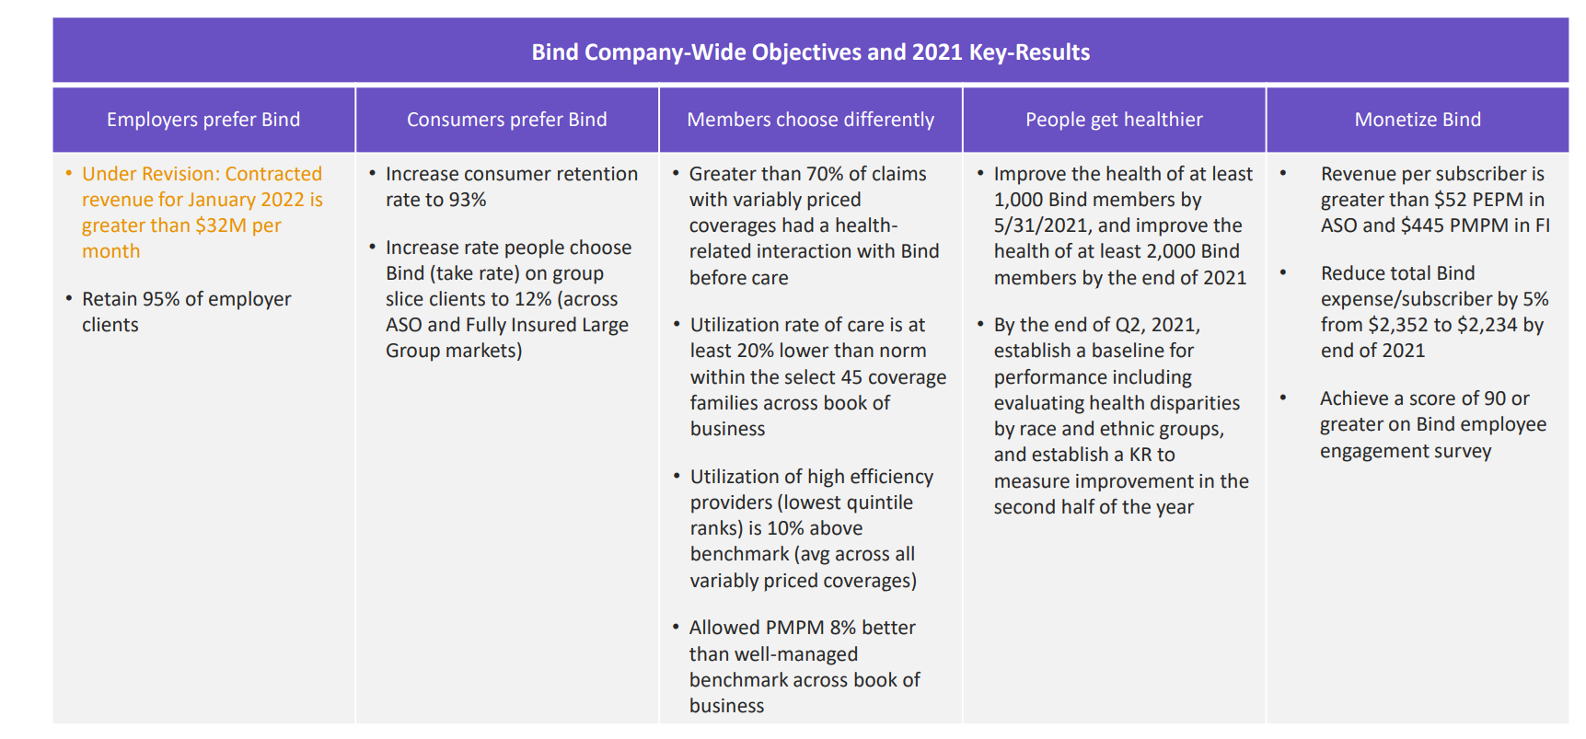
Goal: determine the baseline differences in compliance with evidence-based guidelines for Bind members by race and ethnicity. This will inform our 2022 OKR and identify targeted opportunities to reduce differences in appropriate healthcare use across our members.

Slide 4
Background
Evidence Based Measures (EBM): science-based indicators which summarizes clinical quality of care
Overuse EBM: services that are historically being overused
Underuse EBM: services that are historically being underused
Denominator: members who met the criteria for a given measure (ex. Minimum length of enrollment)
Numerator: members who then received the service
Neighborhood deprivation index (NDI): rankings of neighborhoods (census block groups) by socioeconomic disadvantage in a region of interest. Range 1 – 100 (least disadvantaged - most disadvantaged )
Data source: Milliman MedInsight, predicted race, NDI
Observation level: member – service level
Jan 2019 – April 2021
Number of distinct member: 15,235
Notes:
Ebm: represent various delivery systems and care settings
Overuse ex:

Slide 5
EBM tables

Slide 6
Aggregated measures: Utilization rates of services by predicted race/ethnicity
 | White | Black | Hispanic | Asian Pacific Islander (API)
Measures typically overused | 33% (7478) | 28% (979) | 30% (862) | 44% (304)
Measures typically underused | 61% (9957) | 58% (1028) | 57% (921) | 60% (542)
Note:
For overuse measures, lower % = better
For underuse measures, higher % = better
% = sum numerator / sum denominator
(sum denominator)
Key takeaway: no signs of obvious inequality between groups of members based on predicted race and ethnicity
Notes:
Highlight takeaway: no signs of obvious inequality currently testing for statistical significance

Slide 7
Utilization rates for services that are commonly overused
Overuse EBM | White | Black | Hispanic
Use of Antibiotic Treatment for Acute Bronchitis/Bronchiolitis (Total) | 45% (206) | 31% (16) | 58% (26)
Inappropriate Testing for Pharyngitis (Total) | 27% (599) | 55% (33) | 48% (63)
Use of Opioids at High Dosage | 3% (307) | 0% (44) | 5% (21)
Cesarean Delivery Rate, Uncomplicated (Overall) | 27% (599) | 35% (62) | 26% (53)
Use of Imaging Studies for Low Back Pain | 77% (348) | 76% (41) | 61% (31)
NYU ED Utilization Algorithm: Non-Emergent | 17% (3370) | 23% (545) | 20% (490)
Use of Opioids from Multiple Providers (Multiple Prescribers) | 15% (358) | 13% (53) | 13% (24)
Use of Opioids from Multiple Providers (Multiple Pharmacies) | 4% (358) | 0% (53) | 0% (24)
Use of Opioids from Multiple Providers (Multiple Prescribers and Multiple Pharmacies) | 2% (358) | 0% (53) | 0% (24)
Inappropriate Treatment for Upper Respiratory Infection | 11% (936) | 17% (70) | 19% (98)
Note: for overuse measures, lower % = better

Slide 8
Utilization rates for services that are commonly underused
Underuse EBM | White | Black | Hispanic
Comprehensive Diabetes Care: Hemoglobin A1c (HbA1c) Testing | 82% (1157) | 81% (187) | 76% (138)
Chlamydia Screening in Women (Total) | 34% (1437) | 53% (136) | 41% (116)
Colorectal Cancer Screening | 23% (674) | 35% (20) | 17% (48)
Prenatal and Postpartum Care: Prenatal Care | 33% (283) | 54% (28) | 48% (25)
Prenatal and Postpartum Care: Postpartum Care | 48% (283) | 54% (28) | 36% (25)
Percentage of members 18 years and older who met the PDC threshold of 80% for beta-blockers during the measurement period. | 67% (939) | 45% (112) | 61% (69)
Percentage of members 18 years and older who met the PDC threshold of 80% for Renin Angiotensin System Antagonists during the measurement period. | 76% (2467) | 59% (306) | 63% (230)
Well-Child Visits in the Third, Fourth, Fifth and Sixth Years of Life | 70% (2239) | 56% (192) | 66% (231)
Note: for underuse measures, higher % = better

Slide 9
EBM analysis
Driving research questions:
Are there differences in service use between races/ethnicities after controlling for age, gender, and socioeconomic status?
Is socioeconomic status predictive of receiving services that tend to be overused or underused?

Slide 10
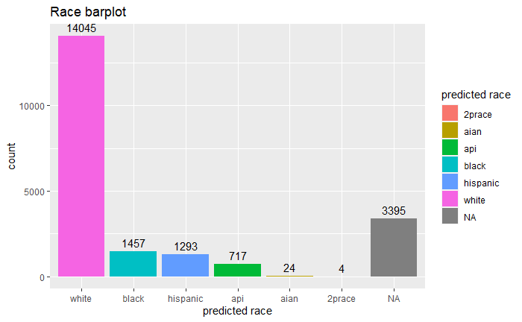
EBM analysis - EDA
Predicted race
Notes:
race NA: members were not active when the race prediction algorithms run 4/6/2021

Slide 11
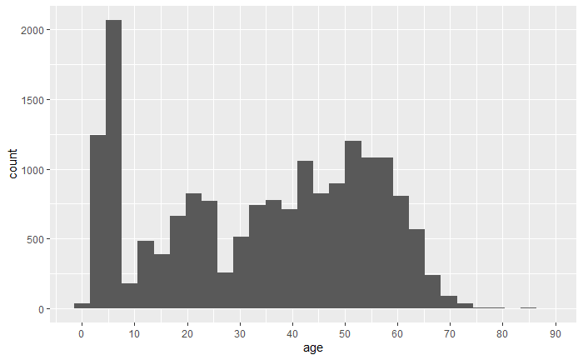
Age
Notes:
Do not take too long here

Slide 12
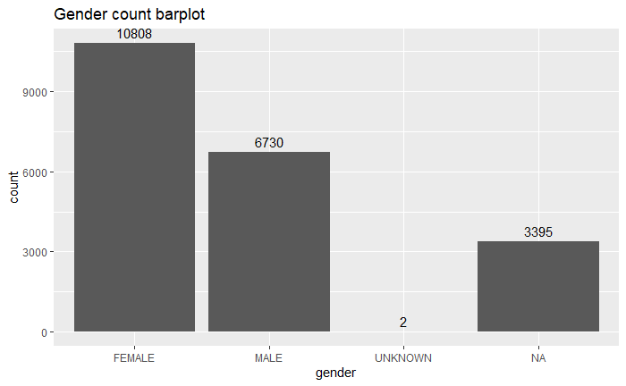
Gender

Slide 13
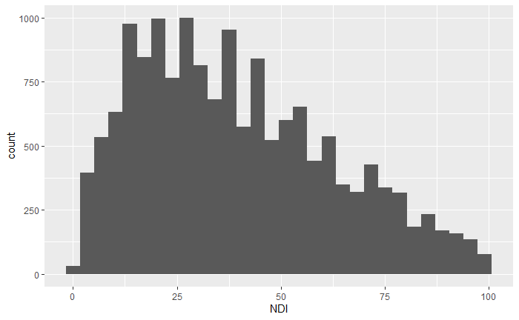
NDI
Least disadvantaged
Most disadvantaged

Slide 14
Numerical summary
Correlation | Age
NDI | 0.122
Predicted race/ethnicity | Average NDI
White | 37.3
Hispanic | 46.4
Black | 60.8
AIAN | 57.2
Weak positive correlation
Gender | Average NDI
Male | 37.4
Female | 40.7

Slide 15
EBM analysis – Methods
Data table: for illustration purpose only
Member number | EBM label | Numerator
12345 | Use of Opioids at High Dosage | 0
12345 | Use of Imaging Studies for Low Back Pain | 0
09876 | Use of Imaging Studies for Low Back Pain | 1
Model Choice: Generalized Linear Mixed-Effects Model (glmer) with binomial response

Slide 16
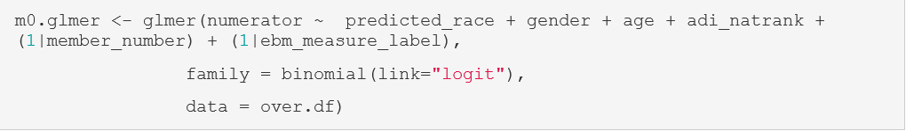
EBM analysis – Results
Overuse EBM
Variable | Estimated Coefficient | P-value
Intercept | 0.22 | 0.75
Predicted race/ethnicity: 2prace | -0.69 | 0.73
Predicted race/ethnicity: AIAN | 1.45 | 0.13
Predicted race/ethnicity: API | 0.04 | 0.85
Predicted race/ethnicity: Black | -0.12 | 0.49
Predicted race/ethnicity: Hispanic | -0.46 | 0.004**
Gender: male | 0.22 | 0.02957*
Age | -0.0296 | <2e-16***
NDI | -0.0046 | 0.01871*
Notes:
Take away

Slide 17
EBM analysis – Results
Overuse EBM
Variable | Odds Ratio
Intercept | --
Predicted race/ethnicity: 2prace | 0.50
Predicted race/ethnicity: AIAN | 4.2
Predicted race/ethnicity: API | 1.04
Predicted race/ethnicity: Black | 0.88
Predicted race/ethnicity: Hispanic** | 0.63
Gender: male* | 1.24
Age*** | 0.97
NDI* | 0.99
Key takeaway: our members who are predicted as Hispanic are less likely to receive overuse services comparing to White

Slide 18
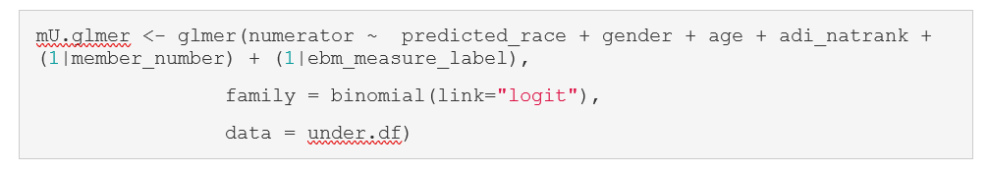
EBM analysis – Results
Underuse EBM
Variable | Estimated Coefficient | P-value
Intercept | -0.97 | 0.005
Predicted race/ethnicity: 2prace | -14.18 | 0.587
Predicted race/ethnicity: AIAN | -0.27 | 0.712
Predicted race/ethnicity: API | -0.05 | 0.635
Predicted race/ethnicity: Black | -0.3 | 0.000294***
Predicted race/ethnicity: Hispanic | -0.25 | 0.0046**
Gender: male | -0.0014 | 0.977
Age | 0.028 | <2e-16***
NDI | -0.003186 | 0.002218**

Slide 19
EBM analysis – Results
Underuse EBM
Variable | Odds Ratio
Intercept | --
Predicted race/ethnicity: 2prace | 0.0000006
Predicted race/ethnicity: AIAN | 0.76
Predicted race/ethnicity: API | 0.95
Predicted race/ethnicity: Black*** | 0.74
Predicted race/ethnicity: Hispanic** | 0.78
Gender: male* | 0.9985
Age*** | 1.03
NDI** | 0.997
Key takeaway: our members who are predicted as Black and Hispanic are less likely to receive necessary (underuse) services comparing to White
Notes:
interpretation for gender, age, NDI less imporatnt. Control for these to understand effect of race better

Slide 20
Challenges
EBM limited to those with sufficient sample size by race/ethnicity subgroups
Missing values: 16% of total rows do not have predicted race/ethnicity available
Limited peer reviewed literature on validation/goodness-of-fit for glmer logistic model

Slide 21
Summary
No obvious inequality of race/ethnicity at aggregate level
Potential inequality under specific measures
Members with predicted race/ethnicity Black and Hispanic are less likely to receive necessary services when comparing to White
Socioeconomic status (NDI) appear to be a significant factor for receiving services

Slide 22
Next steps
Chi-square tests for each of the measures
Explore potential interaction effects
Goodness-of-fit test
MCMCglmm model approach
Updated EBM methodology from Milliman

Slide 23
Bibliography
https://www.neighborhoodatlas.medicine.wisc.edu/
https://englianhu.files.wordpress.com/2016/01/faraway-extending-the-linear-model-with-r-e28093-2006.pdf
https://yury-zablotski.netlify.app/post/mixed-effects-models-4/#effects-soup-fixed-random-nested-crossed
https://cran.r-project.org/web/packages/ggeffects/vignettes/practical_logisticmixedmodel.html
https://stats.idre.ucla.edu/r/dae/logit-regression/

Slide 24
Thank you!

